Slide 1
Future of AI

Slide 2
Scope
Current state of AI
Key players in AI Development
What is next for AI
How can we use AI

Slide 3
Current State of AI
Three stages of AI:
ANI: Artificial Narrow Intelligence
AGI: Artificial General Intelligence
ASI: Artificial Super Intelligence
According to COMPTIA
38% of employees expect their job to be automated
13% expect AI to eliminate positions entirely
Notes:
Narrow artificial intelligence (narrow AI) is a specific type of artificial intelligence in which a learning algorithm is designed to perform a single task, and any knowledge gained from performing that task will not automatically be applied to other tasks.
Artificial General Intelligence (AGI) refers to a theoretical type of artificial intelligence that possesses human-like cognitive abilities, such as the ability to learn, reason, solve problems, and communicate in natural language

Slide 4
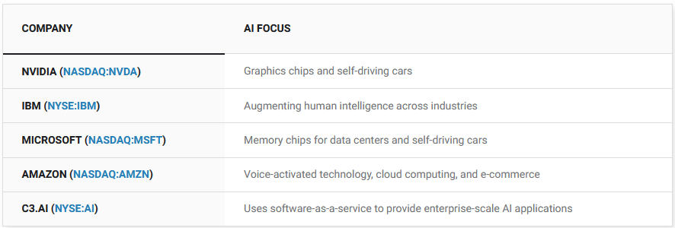
Key Players in AI Development
https://www.fool.com/investing/stock-market/market-sectors/information-technology/ai-stocks/
Notes:
C3.ai is a SaaS company whose software allows companies to deploy large AI applications.

Slide 5

What is next for AI
ASI: Artificial Super Intelligence
possibly the last inventions that humans need to make
will accelerate technological progress across various fields
may also lead to technological singularity
https://www.accenture.com/au-en/insights
Notes:
ASI will be one of the finest and possibly the last inventions that humans would ever need to make as it will constantly evolve to become more intelligent.
Superintelligence will accelerate technological progress across various fields such as AI programming, space research, discovery and development of medicines, academics, and plenty others.
ASI may further mature and develop advanced forms of superintelligence that may even enable artificial minds to be copied.
ASI, in the future, may also lead to technological singularity. Where the technology in no longer in our control and fully conscious.
Some predictions say by 2050

Slide 6
How can Defence use AI
Defence:
Platforms can be offline, meaning ease of integration
Mission planning systems (operations and incident response)
In the field (Diffusion of Explosives, Arms and Ammunition)
Cyber Security:
SIEMs
Malware detection
user analytics
CTI
Notes:
We can integrate into our protected and secrete systems where there are large enough data sets for AI to operate
C3 AI is a prime example, working with many US GOV agencies
DSOC next door. No more neet to greate playbooks and rules for splunk.
Blends back in with the second point, more focus on AI being in the field and performing tasks which put human lives at risk
CTI wont be a thing, anomalies and more will all be picked up by AI, it can surf the dark web and much more

Slide 7
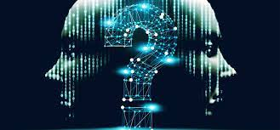
Questions

